Slide 1
How to construct a scaling ambition
Virtual Workshop: “The Scaling Scan”

Slide 2
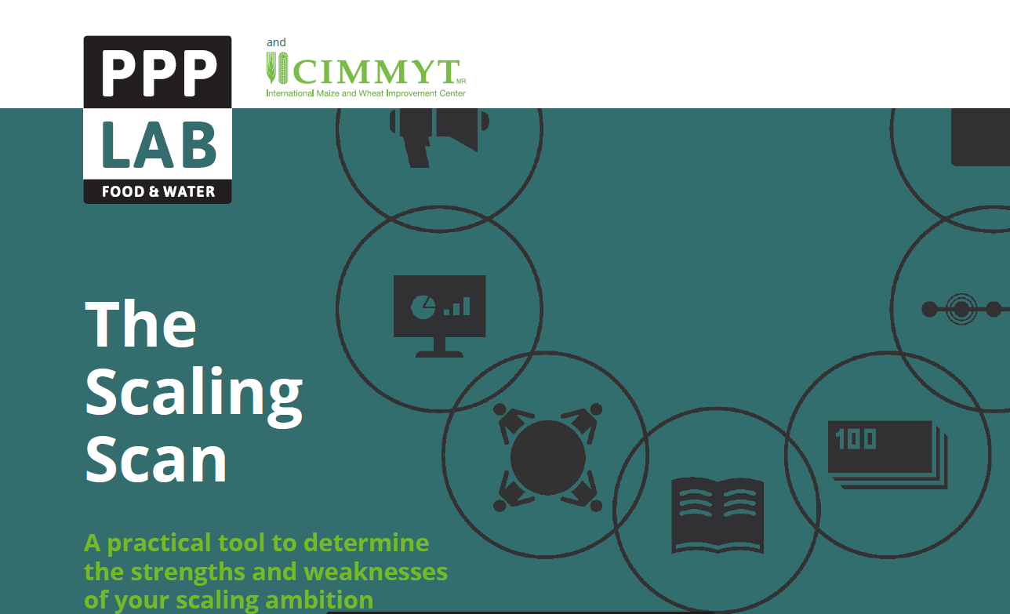
1. Construct a scaling ambition
(what, for who, why, by who…)
2. Assess the status of 10 scaling ingredients for achieving a scaling ambition
3. Identify bottlenecks and opportunities

Slide 3
Step 1. Define a Scaling ambition
The “what to scale” in a context – the where, by when, from whom, who is involved and why is it important.
A responsible scaling ambition - anticipating potential environmental and social trade-offs- and regarded as part of larger systems change.
Think beyond what only one project can contribute.
Images from Pixabay

Slide 4
What?
Innovation = the introduction of something new, a new technology / practice, approach or form of organization
The simpler an innovation, the easier it will be to scale.
Key questions:
What is the most promising innovation identified in projects with the potential to have an impact at scale?
Do you have deep understanding and expertise on that innovation?
What are the essential components for its effectiveness?
The simpler an innovation, the easier it will be to scale.
Fidelity
Simplification
Source: Adapted from MSI -Larry Cooley

Slide 5
Innovation
EXPERTISE
Innovations can be technologies, product, services and practices, but also organizational and institutional arrangements (Sartas, et al, 2020).
Innovations scale as part of packages:
core innovations
complementary/supportive innovations.
Core
innovation
EVIDENCE
MATURITY

Slide 6
Example: Innovations and scaling…
....All these innovations need to scale in parallel to the technological innovation...takes time and resources...
Cellphone
Technological innovation (apps, camera, etc)
Infrastructural innovation (antennas, network infrastructure)
Market innovation (promotions, incentives)
Policy innovation (safety and privacy policies)
Value chain innovation (availability of spare parts & accessories)
Knowledge and skills innovation (training for repairs)
(Source: based on Marc Schut (IITA), 2017)

Slide 7
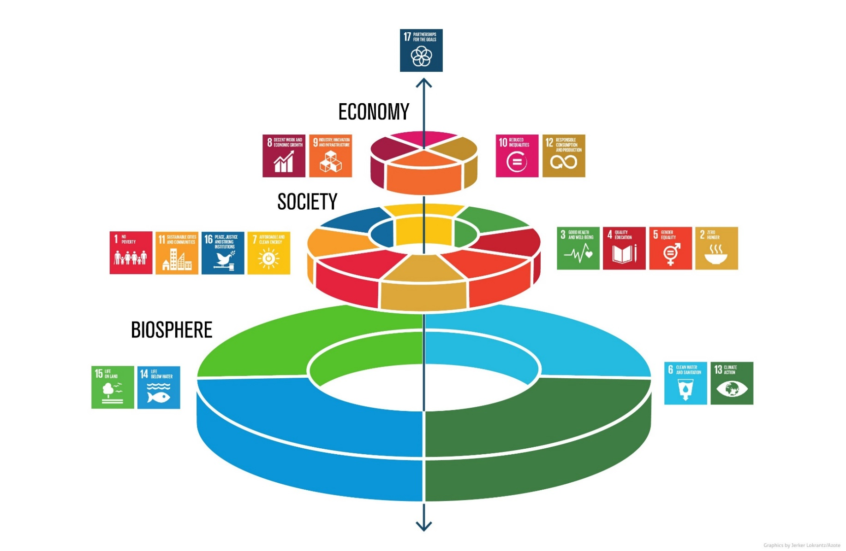
Why?
What persistent problem are you addressing?
What is the larger development outcome (SDGs) you aim to contribute to?
The systems change we contribute to is… 🡪
Source: Stockholm Resilience Centre

Slide 8
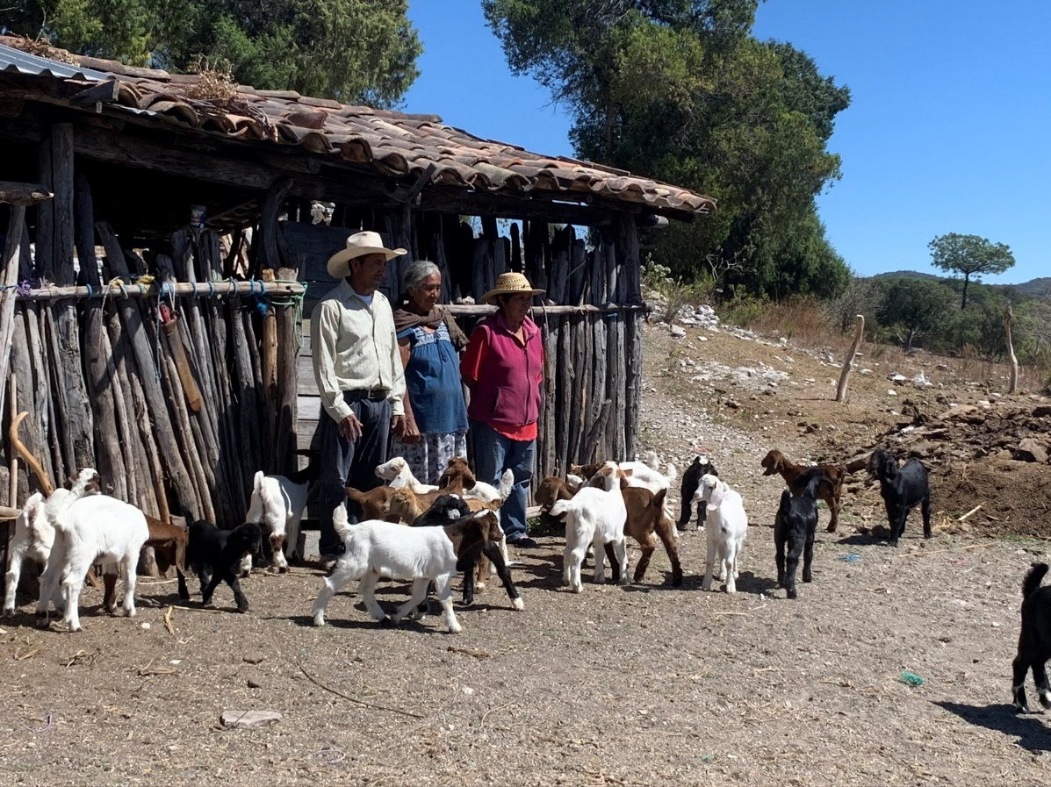
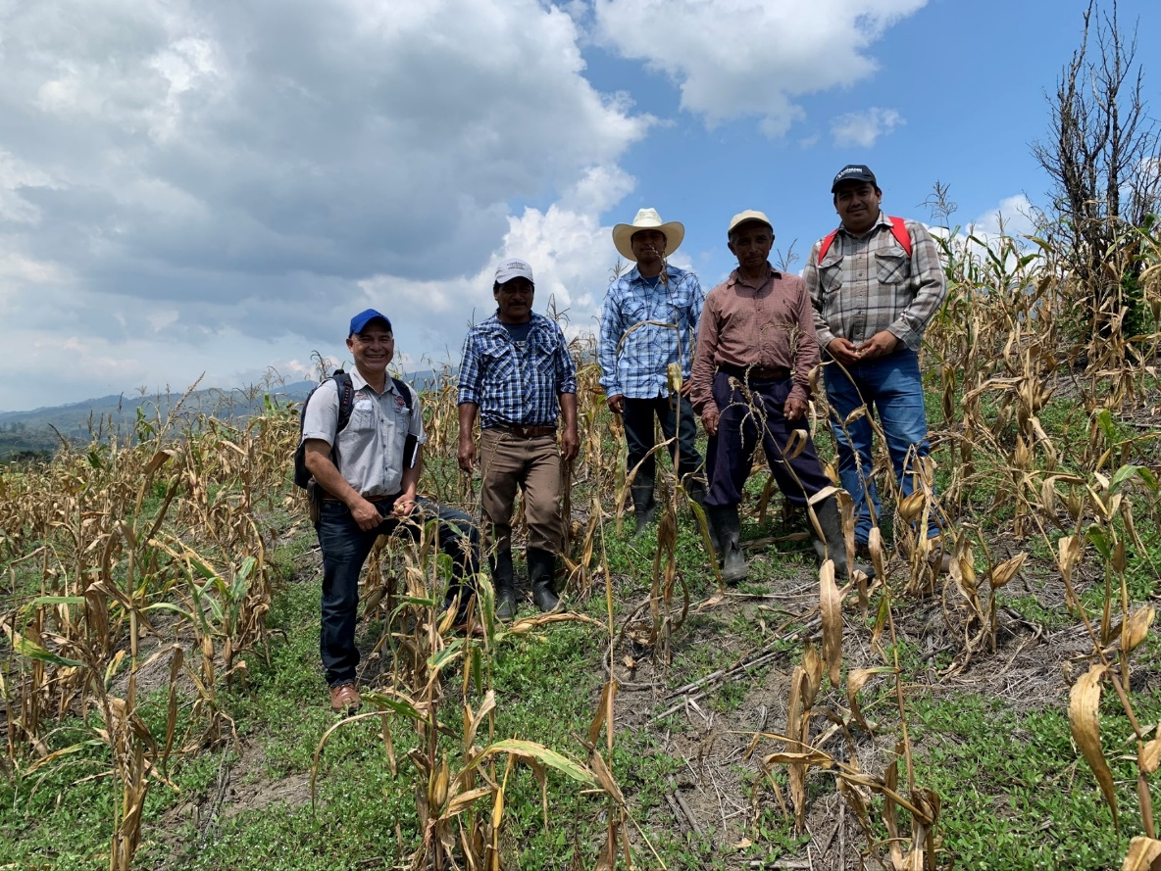
For whom?
Change and sustainability are achieved by people.
Are you targeting end-users, consumers and/ or intermediaries, others?
What specific groups are you (not) targeting who can benefit most from the innovation?

Slide 9
Where?
The intervention area…
What boundaries are you considering?
Are you looking at geographic expansion or more/different target population in the same geography?

Slide 10
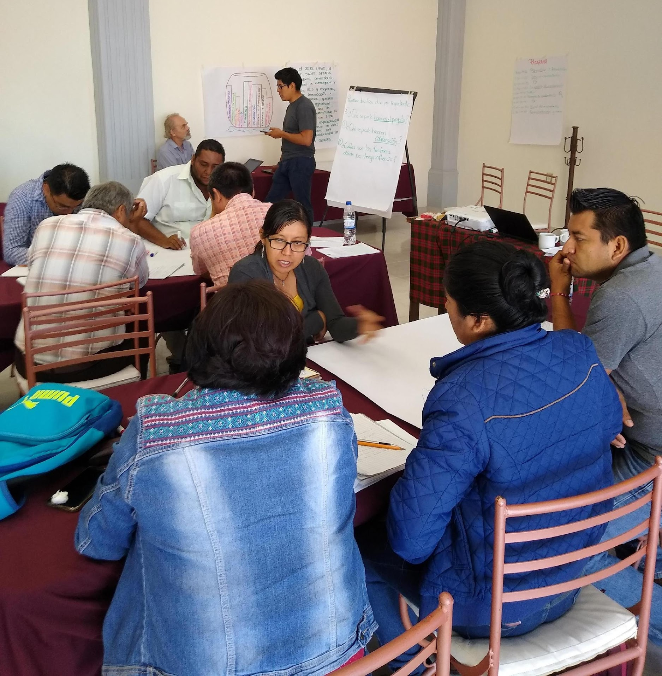
By whom?
Who leads and coordinates the process of achieving the scaling ambition?
Who is most interested and best suited and motivated to do so?
Do they have the mandate and capacity to perform that task?

Slide 11
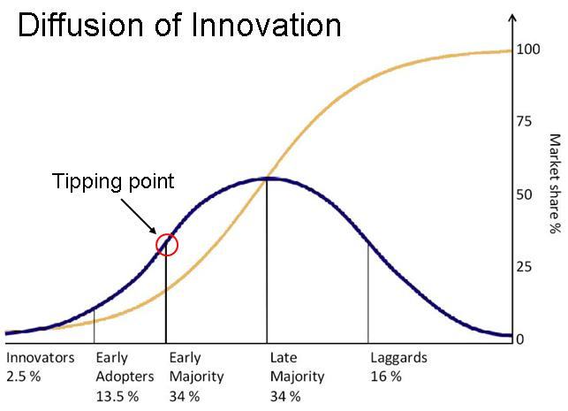
How many?
Rules of thumb to define a realistic target:
The role of a project may be to lift adoption to 15-30% of the maximum- the tipping point - after which scaling is easier.
Aim for a reasonable amount between a maximum and a minimum.

Slide 12
By when?
What is a realistic timeline for achieving the scaling ambition?
Does the leadership for scaling need to be done in phases and handed over at some time? If so, when?

Slide 13
Scaling ambition
What?
Why?
For who?
By who?
Where?
How many?
By when?
By [time], [leading organization(s)] supports the scaling process of [innovation] from [current amount] to [future amount] for [target group] in [intervention area] to [contribution to system change]

Slide 14
How to construct a scaling ambition
STEP 1A
DRAFT A SCALING AMBITION
STEP 1B
SYSTEMS CHECK
STEP 1C
RESPONSABILITY CHECK

Slide 15
Systems check
Systems change happens in phases:
Inception
First movers
Critical mass
Institutionalization
©NewForesight Consultancy BV
The analysis of the system helps us to reflect in what phase we are.

Slide 16
How to construct a scaling ambition
STEP 1A
DRAFT A SCALING AMBITION
STEP 1B
SYSTEMS CHECK
STEP 1C
RESPONSABILITY CHECK

Slide 17
Responsability check
Implications for society and the environment, both positive and negative.
What are the potential negative side effects and implications for reaching the scaling ambition?

Slide 18
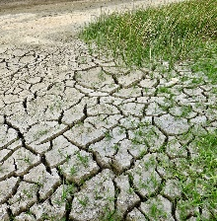
Environmental responsability
Use of resources
Quality of resources
Climate change
Biodiversity

Slide 19
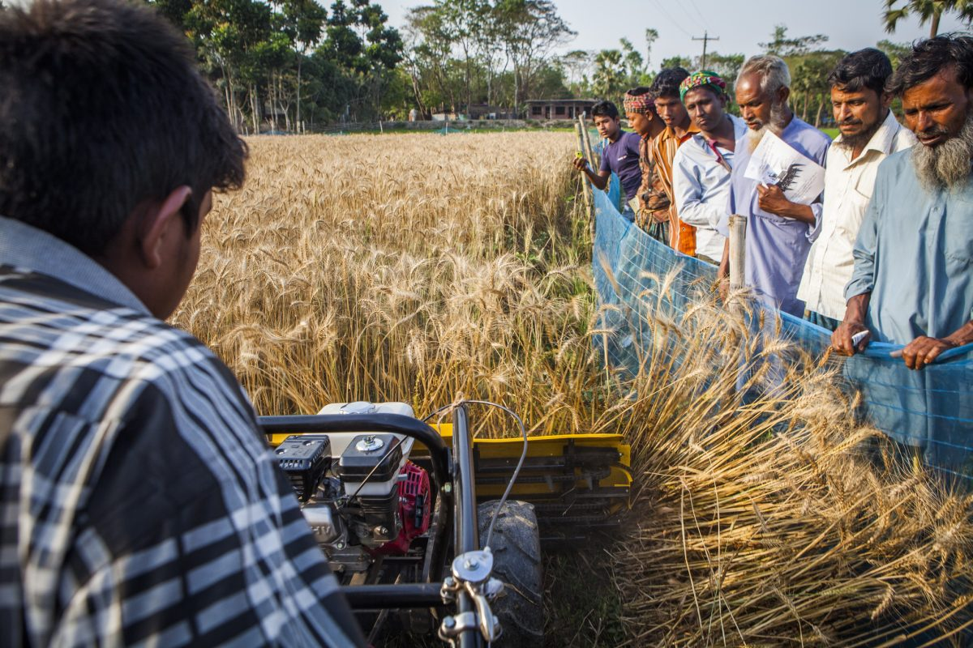
Social responsibility
Gender equality
Age equality
Inclusiveness
Power equity
Resilience

Slide 20
Scaling ambition
When you write down your scaling ambition, consider:
By [time], [leading organization(s)] supports the scaling process of [innovation] from [current amount] to [future amount] for [target group] in [intervention area] to [contribution to system change]
Systems check
Responsibility check

Slide 22
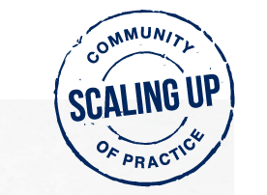
CONNECT US
WEBSITE
TWITTER
E-MAIL
Scaling CoP
www.cimmyt.org
@mxboa @ lennartwol
#scaling4SD #scaling CoP
m.boa@cgiar.org
l.woltering@cgiar.org
ARD working group

Slide 23
Suggested literature
‘Pilots Never Fail, Pilots Never Scale’: Why the Global Development Community Needs a More Realistic Approach to Reaching Billions: https://bit.ly/3b8n1ea
Scaling – from “reaching many” to sustainable systems change at scale: A critical shift in mindset: https://bit.ly/34GLOVL
Scaling impact: innovation for the public good: https://bit.ly/3bci4Bo
Scale up Sourceboook: https://bit.ly/31CJcWY

