Slide 1
The Scaling Ingredients
Virtual Workshop: “The Scaling Scan”

Slide 2
1. Construct a scaling ambition
(what, for who, why, by who…)
2. Assess the status of 10 scaling ingredients for achieving a scaling ambition
3. Identify bottlenecks and opportunities

Slide 3
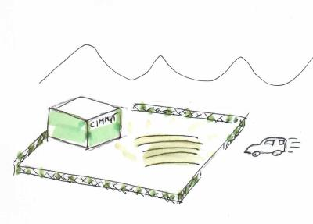
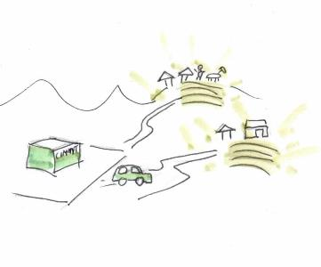
Discovery
Proof of concept
Piloting
Scaling
?
Notes:
We don’t really know what is the back box, and we want to understand what’s happening in that black box…
Larry Cooley: Successful Pilot + Hope = Change at scale
Lets characterize pilot projects and Scaling
CIMMYT has not had success going from Piloting to Scaling, but other organization had the same problem (SNV, GIZ, IFAD, USAID)

Slide 4
1. Technology/practice
10. Public sector governance
2. Awareness and demand
9. Leadership and management
3. Business cases
+ Sustainable
+ Responsible
+ Systemic
8. Evidence and
learning
4. Value chain
5. Finance
7. Collaboration
6. Knowledge and skills

Slide 5
The Scaling Ingredients
Each ingredient changes the taste of another;
The perfect combination or flavor depends on the context;
What ingredients do we have? Which ones are missing?

Slide 6
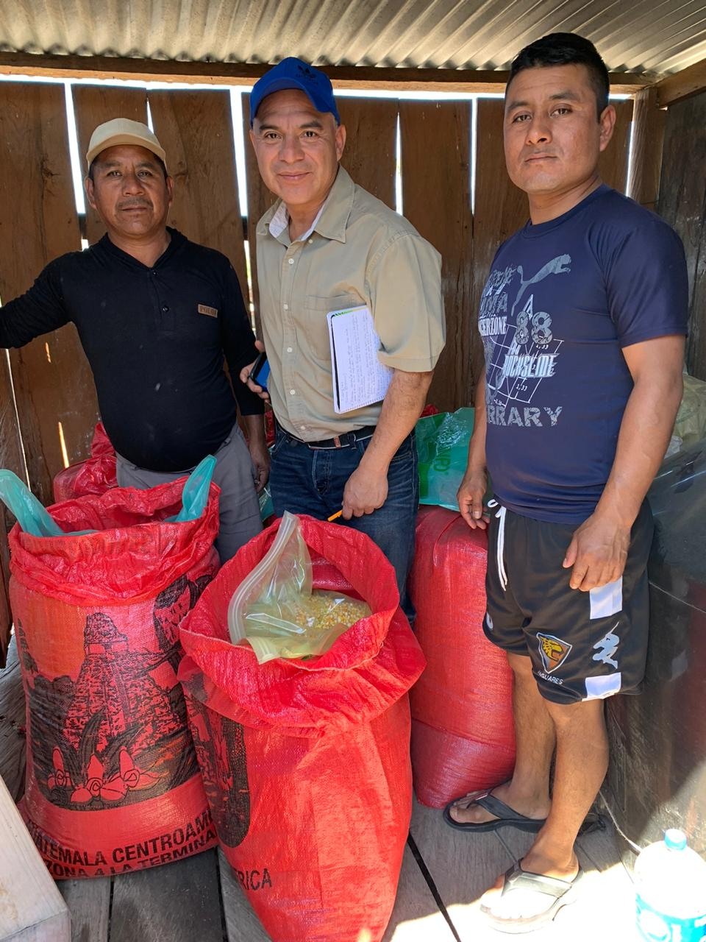
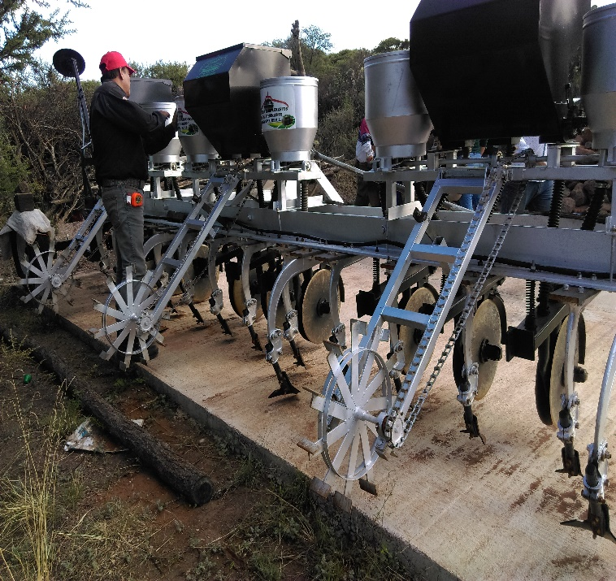
Technology / practice
An effective and efficient
innovation for the issue at stake
Characteristics of the innovation:
Relevant
Comparative advantage
Easy to understand and use
Compatible with local needs, circumstances and preferences

Slide 7
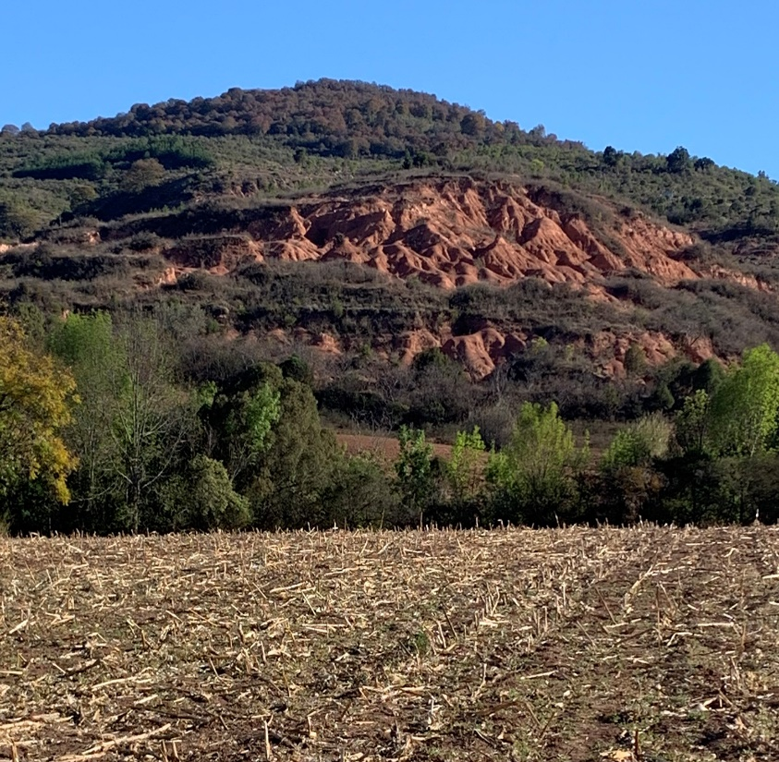
Awareness and demand
A wish and readiness to use and produce the innovation
Desire and need recognized
Existence of information and effective communication channels
Evidence of potential demand

Slide 8
Business cases
Incentives and attractive value propositions to support the scaling of the innovation
Viable business cases for the innovation
Enough information available
Interest of the supply chain actors to invest time and resources
Business climate conducive

Slide 9
Value chain
Effective links between actors to pursue business cases and bridge supply and demand
The innovation can be supplied in the right quality, quantity, and in a timely manner;
Adequately developed relations between the various actors in the supply chain;
Performance of the sector value chain conducive to scaling
Target group and other value chain actors adequately organized.

Slide 10
Finance
Effective financing options to produce, deliver, manage and acquire the innovation
Purchase / financing capacity of the target group
Available, accessible, and affordable financial mechanisms
Sufficient and sustainable funding
Financial risks acceptable

Slide 11
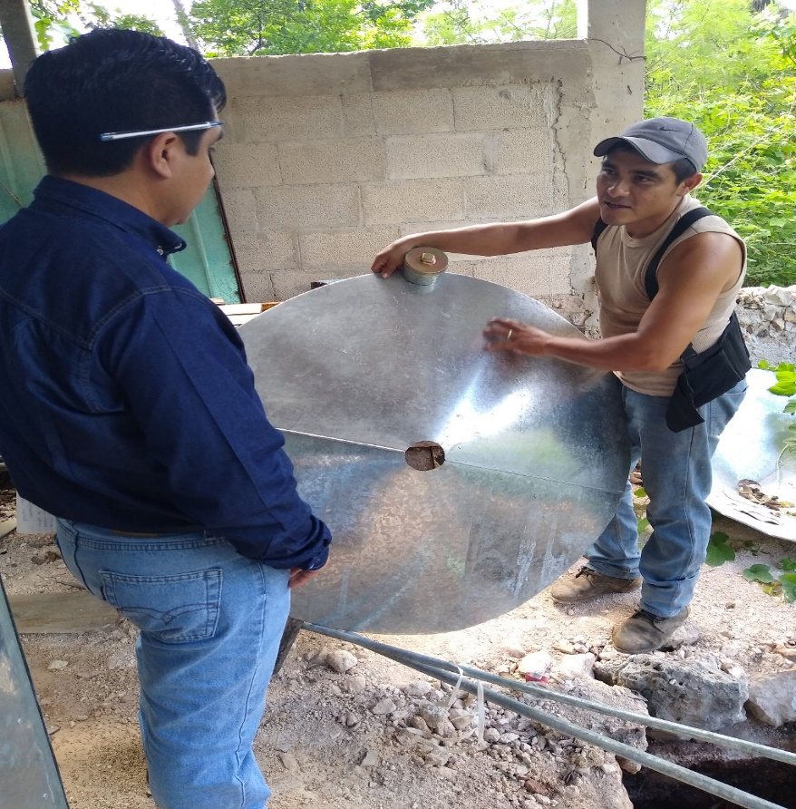
Knowledge and skills
Capacities at individual and institutional level to use, adapt and promote the innovation at scale
The target group knows how to use innovation and has the necessary skills to do so.
Available appropriate training materials and methods
Provision of (local) training programs
Institutional environment conducive to develop and improve the innovation within the national and local system.

Slide 12
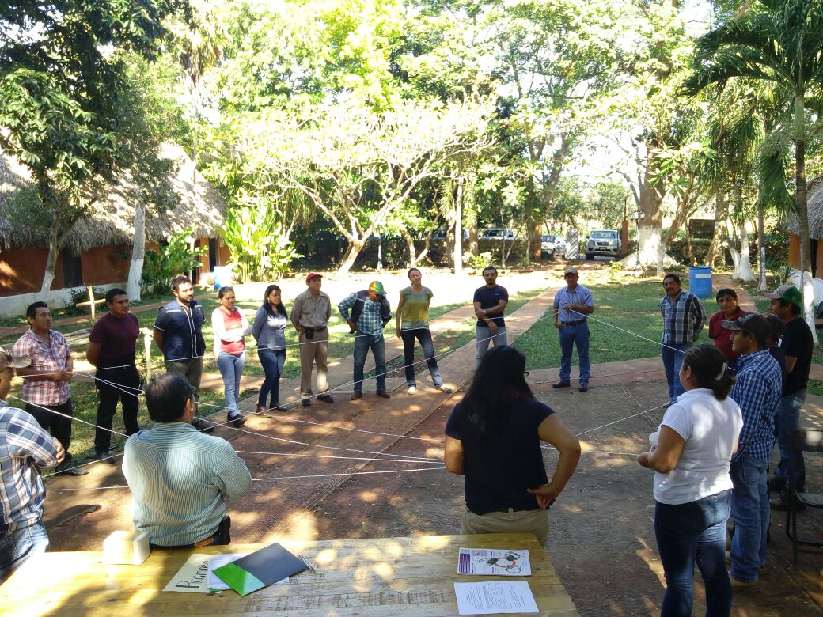
Collaboration
Strategic collaboration within and beyond the sector to scale the innovation
Relevant stakeholders involved that can operate at scale and/or sustain the scaling of the innovation engaged
Definition of roles and responsibilities
Existence of effective networks and platforms
Effective links with parallel initiatives
or policy processes

Slide 13
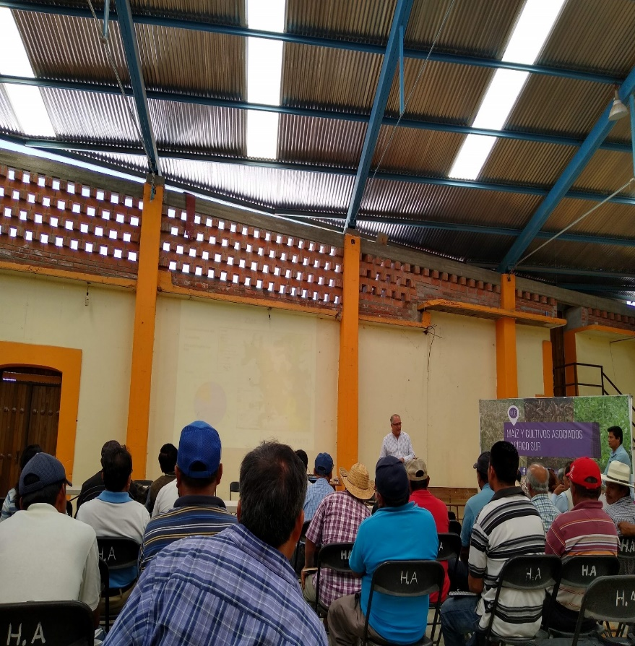
Evidence and learning
Credible evidence and facts underpin and help gain support to reach the scaling ambition
Available useful and credible data
Effective use of data and knowledge management tools
Decision-making based on data
Institutional learning

Slide 14
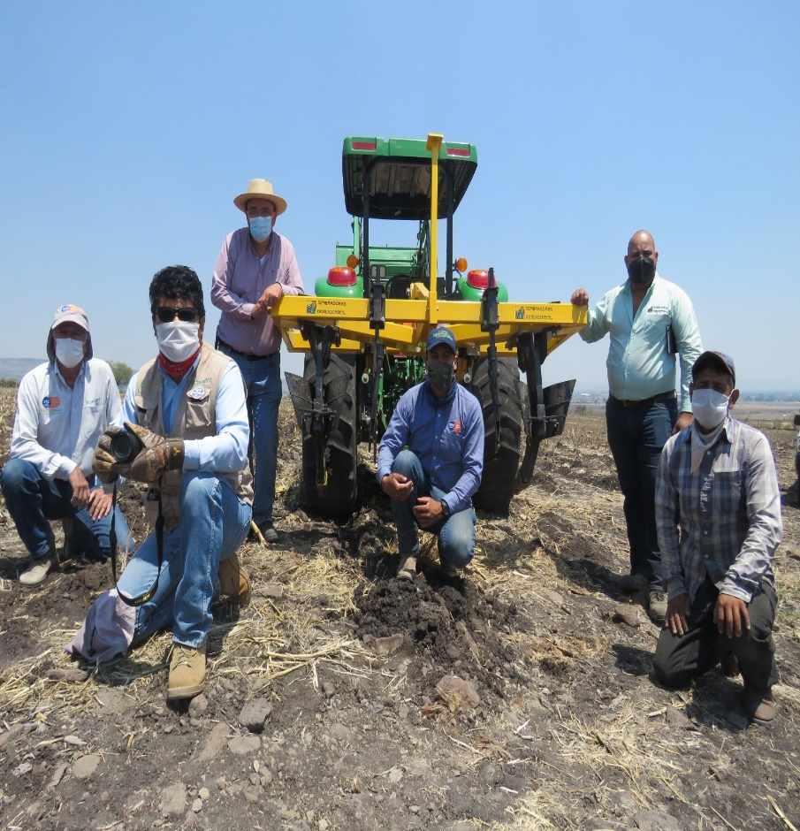
Leadership and Management
Effective coordination and navigation to achieve the scaling ambition
Established, recognized and connected leadership
Involvement of key stakeholders in decision-making process
Spokespersons or ambassadors
Change management processes to effectively pursue the scaling ambition

Slide 15
Public Sector Governance
Government support to reach the scaling ambition
Clarity of the role and responsibilities of the government
Conducive public policies, norms and regulations
Recognition and support by government agencies
Available public financing mechanisms

Slide 16
1. Technology/practice
10. Public sector governance
2. Awareness and demand
9. Leadership and management
3. Business cases
+ Sustainable
+ Responsible
+ Systemic
8. Evidence and
learning
4. Value chain
5. Finance
7. Collaboration
6. Knowledge and skills

Slide 17
How to assess them?
Each question should be scored on a scale from
1 (☹) to 5 (☺) to represent your level of confidence for reaching your scaling ambition.
"How confident are you that you will achieve your scaling ambition, considering the current status and planned activities of this particular ingredient?"
Scoring levels include:
5 = Yes definitely, this is not an issue for my Scaling case OR not applicable
4 = Quite confident
3 = Some doubts/unsure
2 = Serious doubts
1 = No, this is very uncertain OR not enough information to answer
☺
☹
Notes:
Si, no es aplicable, no es un problema para el escalamiento, y por eso recibe una puntuación positiva de 5.

Slide 19
CONNECT WITH US
WEBSITE
TWITTER
E-MAIL
Scaling CoP
www.cimmyt.org
@mxboa @ lennartwol
#scaling4SD #scaling CoP
m.boa@cgiar.org
l.woltering@cgiar.org
ARD working group

